Slide 1

MCRD Parris Island / Eastern Recruiting Region
"We Make Marines"
EQUAL OPPORTUNITY ADVISORS (EOA)
MCRD / ERR PI | 1st MCD, ERR | 4th MCD, ERR | 6th MCD, ERR
MSgt Andrea M. Cole | SSgt Andrew C. Gilbert | GySgt Cassie Lauderdale | SSgt Beau Glenn
andrea.cole@usmc.mil | andrew.gilbert@marines.usmc.mil | cassie.Lauderdale@marines.usmc.mil | beau.glenn@usmc.mil
843-228-3567 | 516-228-2173 | 614-619-5869 | 843-228-3567
MILITARY EQUAL OPPORTUNITY PROGRAM
Prohibited discriminatory and harassment practices within the Marine Corps are counter-productive, unacceptable, and will not be tolerated. The Marine Corps will maintain a culture of dignity, care, and concern in which all members of the organization are afforded equal treatment and opportunity to achieve their full potential based upon individual merit, fitness, intellect, and ability. All Service members will cultivate an environment free from prohibited activities and conduct (PAC).
PAC includes: Harassment, Bullying, Hazing, and Sexual Harassment, as well as Prohibited Discrimination based on race, color, national origin, religion, sex (including pregnancy), gender identity or sexual orientation.

Slide 2
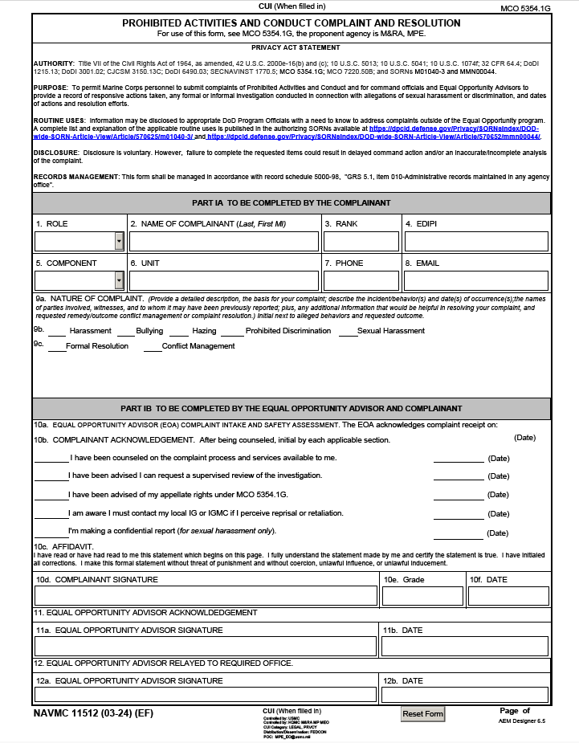
MCRD Parris Island / Eastern Recruiting Region
"We Make Marines"
COMPLAINT PROCESS
Service members who wish to file complaints of PAC shall consult with their servicing EOA to complete NAVMC Form 11512.
Service members may submit Informal, Formal, or Anonymous complaints within 90 calendar days from the most recent incident (120 days for Reserve component Service members).
Service members have the option to confidentially report sexual harassment. Reports should only be disclosed to: EOA, victim service providers, or healthcare personnel. Confidential complaints must be submitted to the EOA within 90 days of most recent incident. This will not be reported to the chain of command but will allow for support resources and referrals.
Service members may file a complaint through:
Equal Opportunity Advisor
Inspector General Office https://hotline.usmc.mil
NCIS Tip Line https://www.ncis.nav.mil/Resources/NCIS-Tips/
Anonymous Complaint
For more information: PAC Prevention & Response Policy, MCO 5354.1G

Slide 3



MCRD Parris Island / Eastern Recruiting Region
"We Make Marines"
SUPPORT SERVICES
Chaplain Services:
MCRD/ERR PI Chaplain……………………………(843) 228-3601
Duty Chaplain………………………………………….(843) 321-6285
Counseling Services & Resources:
MCCS Community Counseling Program….. (843) 228-2044
Military & Family Life Counselors
Military OneSource………………………………… (800) 342-9647
Veterans Crisis Line………………………………….988 then Press 1
National Suicide Prevention Hotline………..988 or (800) 273-8255
National Domestic Violence Hotline………..(800) 799-7233
Sexual Assault Prevention & Response
MCRD PI SARC……………………………………….…(843) 228-3601
ERR SARC…………………………………………….……(843) 321-6285
DoD Safe Helpline…………………………………….(877) 995-5247
Victim Assistance:
Victim & Witness Assistance Program……..(843) 228-4095
Victim's Legal Counsel……………………………..(843) 228-4801
Family Advocacy Program VA……………..……(843) 228-7093
Legal Assistance:
Law Center, Parris Island………………………….(843) 228-2925

