Slide 1
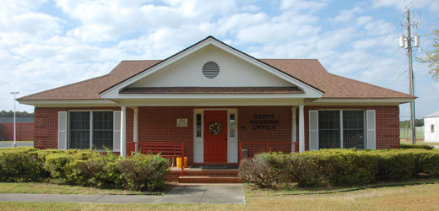
Public Private Venture (PPV) Housing Plain Language Brief (Tenant Welcome & Orientation)
MCRD PARRIS ISLAND
Military Housing Office
Marine Corps Installations Command (MCICOM)

Slide 2
Table of Contents
Section | Topics
Welcome and Background | Welcome; MHO and PPV Partner Contact Information; MHO Services and Responsibilities; PPV Partner Information
Understanding Your Lease | Understanding Your Lease; Fees and Payments; Tenant Responsibilities
Moving In | What to Expect: Move-In and Move-Out; Renters Insurance Overview; Tips for Renters Insurance
Home Maintenance | Maintaining Your Home; Window Safety Tips; Maintenance Issues; Types of Service Calls
Your Rights as a Tenant | Tenant Bill of Rights; Dispute Resolution Process Overview; Informal and Formal Dispute Resolution Processes; Dispute Resolution Process Issues
Additional Contact Information | Social Media and Website Links
October 2021
2

Slide 3
Welcome!
The Military Housing Office (MHO) welcomes you to MCRD PARRIS ISLAND where our MISSION is to ensure the MILITARY SERVICE MEMBERS in Public Privatized Venture (PPV) housing are provided with a comfortable, adequate, well-maintained and managed living facilities that shelters them and their families. In addition, provide mediation if needed by resident that complies with fair housing objectives.
This brief is an introduction to your MHO and PPV Partner and includes your rights and responsibilities as a tenant.
MCRD PARRIS ISLAND is a privatized company that owns and manages your rental property. The MHO, your government point of contact (POC), will assist you with any housing concerns
As a tenant, you are encouraged, but not required, to purchase renters insurance for your property. Additional information on renters insurance is found within this brief and is available from your MHO upon request.
October 2021
3

Slide 4
Contact Information
MHO Contact Information | PPV Partner Contact Information
Street Address: 402 Boulevard De France MCRD Parris Island, SC 29905 | Street Address: 640 Laurel Bay Rd. Beaufort, SC 29960
Phone: (843) 228-2853 (843) 228-2244 | Phone: (843) 846-5300 (877) 749-3724 Maintenance: (877) 509-2424
Website: http://www.mcrdpi.marines.mil/ | Website: www.tc.atlanticmcc.com www.lendlease.com
Facebook/Social Media: (N/A) | Facebook/Social Media: https://www.facebook.com/ TriCommand/
Email: PARR_SMB_MCRDPI_HOUSING | Email: Leasing Office mthames@tricommand.com
October 2021
4

Slide 5
MHO Services and Responsibilities
Installation Commander:
Col. William J. Truax Jr.
Installation Housing Director:
Mr. Albert Kight Jr.
The MHO is here to assist you with:
Advocacy on your behalf with the PPV Partner
Applications for service members seeking referrals to live in family housing
Home referral services for off-base housing
Fair Housing Act concerns or complaints
Assistance during move-in, move-out, and other inspections performed by PPV Partner at resident’s request
MHO contact for next duty station
Housing questions and concerns
Assistance in the dispute resolution process
October 2021
5

Slide 6
AMCC Tri-Command at MCRD Parris Island
PPV provides benefits that are not typically offered in community rentals:
Rent cannot exceed the basic allowance for housing (BAH) with dependents rate
No upfront costs including application fees for Service members
No credit history or salary requirements
Basic utilities are included with rent
PPV Project
AMCC Tri-Command housing is located conveniently at Laurel Bay, MCRD Parris Island, and Naval Hospital. Amenities includes pool, playgrounds, boat ramp, boat & RV storage and community center with Wi-Fi, gym and computer center.
PPV Partner
AMCC Tri-Command also has community events, Resident Advisory Board (RAB) and Department of Defense Education Activity (DoDea) schools.
October 2021
6

Slide 7
Understanding Your Lease
Tenants must accept and sign the PPV lease with DoD approved language. The lease includes tenant’s rights and responsibilities. The resident handbook is considered part of the lease
Face-to-face lease signing is available and encouraged, especially if the tenant has questions. DocuSign is the recommended electronic signing option
In addition to the lease itself, the PPV lease includes several addenda:
Addendum 1 – Electronic Lease Acknowledgement
Addendum 2 – Discounts
Addendum 3 – Community Guidelines
Addendum 4 – Renter Insurance
Addendum 5 – Resident Safety Information
Addendum 6 – Fitness Center Access
Addendum 7 – Contact Information
Addendum 8 – Fire Prevention
Addendum 9 – Tree Swing
It is important to read through and understand what you are signing. If you have questions on your lease, contact the PPV Partner
October 2021
7

Slide 8
Fees and Payments
Tenants may be charged additional fees authorized by the lease and the DoN
The following are the fees authorized by the lease and the DoN:
Fee 1 – If a Service Member is Single and living in the Barracks, BAH will not START until they clear the barracks. MHO cannot start the PPV/BAH deduction until BAH starts. Service member’s may move into housing prior to BAH starting and therefore will be will be required to pay 1-3 days out of pocket until BAH actually starts.
Fee 2 – NAVY, If a Service Member is in the Navy, MHO cannot do a PPV/BAH deduction. The allotment system setup for the Navy is with MAC allotment. The allotment is started by AMCC or by the Service member.
The Service member will be requirement to pay out of pocket prior to the
allotment starting. Example, if they move in on the 1st of the month, they will be required to pay for the full month’s rent out of pocket. If they move in on the 15th of the month, they will be required to pay prorated for half month’s rent. The next month’s rent will be paid by the Navy MAC allotment.
It is important to read through and understand what you are signing. If you have questions, contact the PPV Partner and MHO if necessary
October 2021
8

Slide 9
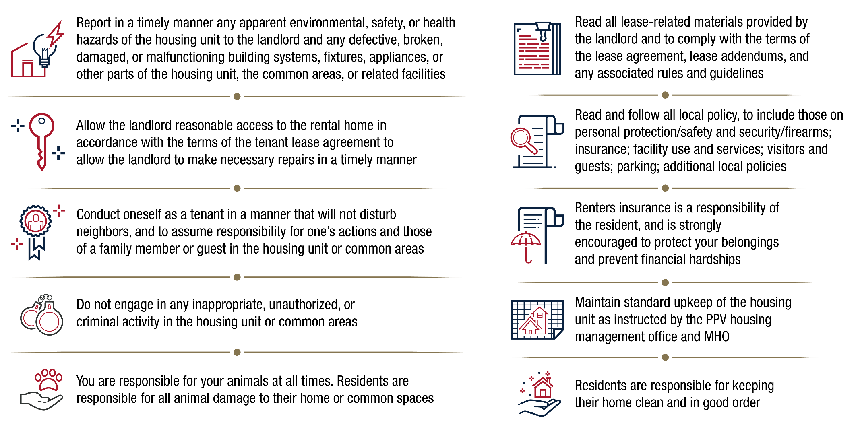
Tenant Responsibilities
Per your lease, you have several responsibilities to fulfill:
October 2021
9

Slide 10
What to Expect: Move-In and Move-Out
MOVE-IN
MOVE-OUT
The Resident:
Tours the home for quality
Accepts home and terms of lease
Signs a lease
AMCC Tri-Command provides:
Walk-through tour of your home
Move-in inspection with checklist
Lease signing and answers to questions
Keys
A survey asking about your move-in experience
MHO provides:
Plain Language Brief and answers to housing policies/questions
MHO Representative at your move-in inspection
Follow-up to check-in with you (15 and 60 day)
Support to resolve any unresolved concerns at move-in
The Resident:
Provides a minimum of 30-day notice to vacate to AMCC Tri-Command
Returns the home in good condition
AMCC Tri-Command provides:
An inspection prior to move-out to assess the condition of your home utilizing the move-in inspection checklist
Appropriate maintenance services and a speedy issue resolution
A final determination of any damages or repairs and associated costs
A move-out survey for you to provide feedback
MHO provides:
Provides answers to questions and issue resolution process
MHO representative at move-out inspection
PCS assistance and MHO contact for your next location
Support on any issues
October 2021
10

Slide 11
Renters Insurance Overview
You are strongly encouraged to purchase renters insurance to protect against personal loss or liability due to unforeseen circumstances
*Renters Insurance is NOT part of the rent you pay to the PPV Partner
What is renters insurance?
A renters insurance policy is insurance for those renting any type of housing which protects your personal property against damage or loss and protects you from personal liability (i.e., financial loss) for damage to the rental property associated with your actions, or for someone that is injured while on the rental property you are occupying
Why purchase renters insurance? The insurance carried by the PPV Partner doesn’t cover your personal property if it is stolen or damaged as a result of a fire, theft, or other unexpected circumstances. If you want to protect your personal belongings, and have liability protection, purchase a renters insurance policy with liability coverage
Renters insurance will reimburse you for personal property destroyed by a fire. If you accidentally set fire to someone else’s property, the personal liability provision will help reimburse the cost of their damaged belongings
Renters insurance typically protects items stolen after a break-in at your rental property, or even items stolen outside of your rental
Personal liability coverage is part of a standard renters insurance policy. It may help pay for another person's medical bills if you're found legally responsible for their injuries
Damage to your possessions from a burst water pipe is typically covered under renters insurance
October 2021
11

Slide 12
Tips for Renters Insurance
For more information on renters insurance, ask your MHO for a copy of the Tenant Guide to Renters Insurance. The MHO can assist you with general questions, while the Legal Services Support Section (LSSS) will assist you in understanding different policies
The National Association of Insurance Commissioners indicates the average renters insurance policy costs between $15 to $30 per month. *Cost may vary depending on your location, choice of deductible, and coverage amounts
Make sure you know what your policy covers. Insurance terms and conditions vary by provider. Be sure to read your insurance policy carefully to understand what may or may not be covered. For example, a liability policy may not cover structural damage from personally owned appliances
Renters insurance is widely accessible and may be available through your car insurance company. Make sure to ask about any discounts and bundling options
Don’t Waive the Liability Coverage! Your insurer will help cover the costs if you’re held responsible for injuring another person or damaging another person’s property, including your rental property. The typical renters insurance policy offers $100,000 in liability coverage
October 2021
12

Slide 13
Maintaining Your Home
Please be aware of local guidance and report maintenance issues immediately to your PPV Partner
Promptly clean kitchen counters and dispose of food debris
Keep food in air-tight containers
Clear outside doorways and windows of leaves and dirt
Check your toilets and faucets for leaks
Use exhaust fans in bathrooms and laundry rooms
Report leaks and maintenance issues immediately
Check drains and keep them clear
Check your filters per directions by your PPV Partner
Clean and monitor major appliances
Check and change batteries for smoke/CO detectors per directions by your PPV Partner
October 2021
13

Slide 14
Window Safety Tips
Windows are among the top 5 hidden hazards in the home. Before opening a window, know the risks they pose to children
Window Safety Tips
All windows above the first floor should have a Child Fall Hazard warning sticker
Do not rely on screens to prevent a window fall
Only open windows that are out of reach if you need ventilation
Child Safety Tips
Encourage children to play in the center of the room and away from open windows
Keep close attention to furniture, or anything children can climb, near open windows
PPV Partners and MHOs across the nation are working towards installing window safety measures to ensure a safer environment for our Marines, Sailors, and their Families
October 2021
14

Slide 15
Maintenance Issues
How to Report Maintenance Issues
Report maintenance issues (maintenance emergencies, trouble calls, safety concerns, compliance issues) right away by contacting your PPV Partner
For an emergency maintenance, call:
(877) 509-2424
For an urgent maintenance, call:
(877) 509-2424
For routine maintenance, call:
(877) 509-2424
Maintenance Number:
(877) 509-2424
Web Portal:
https://www.rentcafe.com/residentservices/atlantic-marine-corps-commmunities_at_tri_command/userlogin.aspx
Download the App: Rent Café
RENTCafe.com helps you save time and manage your new rental effortlessly, from anywhere. Log into your Resident Portal, make and keep track of rent payments, maintenance requests, and lease renewals.
Submit routine service request and view current work order status.
View your account balance and pay rent online.
Receive notifications about the community, announcements and events
Electronically submit residents forms.
Update your contact information
Contact your PPV Partner if you have concerns on maintenance, work orders, repairs, or services
October 2021
15

Slide 16
Types of Service Calls
Type of Service Call | Description | Examples | Response Time
Emergency | Critical safety, life threatening issues Resident with a medical requirement for stable temp levels | Gas leaks Fire Power outage Sewage back-up Flood No toilet available for use Refrigerator inoperable | 30-minute initial response 1 day to complete emergency work Available 24/7/365
Urgent | Habitability issues | Broken window Garage door inoperable Kitchen sink back-up Lights flickering or non-working light-fixtures Presence of mold/mildew | 4-hour initial response 1 business day to complete work
Routine | Convenience Unit care issues | Single burner inoperable Repair screens Light bulb replacement | 1 working day initial response 1 business day to complete work
October 2021
16

Slide 17
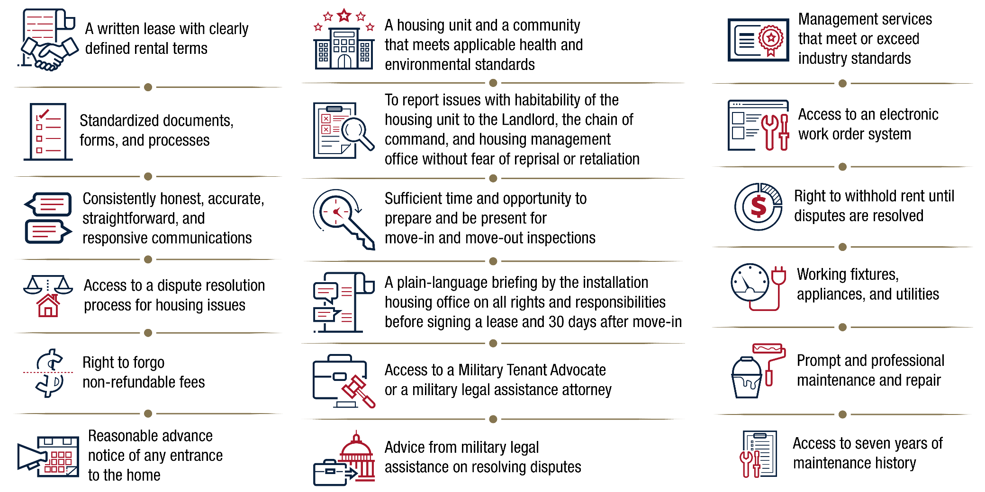
Tenant Bill of Rights
In 2020, laws were passed to assure PPV military residents’ basic rights. MHO will provide residents with a full Tenant Bill of Rights for review
October 2021
17

Slide 18
Dispute Resolution Process Overview
Active duty Service Members and their families living in PPV housing have access to the dispute resolution process (DRP), ensuring prompt and fair resolution for housing issues. The DRP has two components: an informal and formal process.
1
2
Informal DRP
If you notice an issue at your property, contact your PPV Partner to resolve it
You are encouraged to utilize the informal process as your housing issue will be resolved in an efficient manner
Formal DRP
You must first attempt to resolve your housing issue through the informal DRP before you can initiate the formal DRP
The formal DRP is expected to take 30-60 days
Your MHO serves as your advocate throughout the informal and formal DRP.
To explore the DRP further, please visit the Marine Corps MHO Website (https://bit.ly/3n2zyGe)
October 2021
18

Slide 19
Informal Dispute Resolution Process
The dispute resolution process starts with an informal process of communication between you and the PPV Partner. You are encouraged to utilize the informal process as your housing issue will be resolved in a more efficient and timely manner
If you find a problem at the property where you currently reside, contact your PPV Partner so they can take steps to properly resolve the issue
Elevate to the PPV Partner Regional Manager if the action taken is unsatisfactory
If the PPV Partner or Regional Manager does not resolve the issue, contact the MHO and inform them of the problem at your property. The MHO may investigate the issue
If you are not satisfied that your housing issue has been solved, your MHO will provide you with a form which can be filled out, initiating the formal dispute resolution process
October 2021
19

Slide 20
Formal Dispute Resolution Process
The formal dispute resolution process begins once you submit the request form provided by your MHO. You must first attempt to resolve your issue through the informal DRP before you can initiate the formal DRP
2. Participate in the Inspection If the condition of the property is the subject of the dispute, the MHO will schedule an inspection of the property with your PPV Partner
3. Cooperate with the Investigation The Investigator will review all records and conduct interviews as necessary
4. Recommend Action Send recommendation to Regional Commander. If you disagree with the Commander’s recommendation, submit a rebuttal
5. Final Decision Issued Regional Commander will consider your rebuttal and provide you a final decision on the dispute
1. Complete Request Form Complete Request Form and submit to the MHO who will determine eligibility
October 2021
20

Slide 21
Dispute Resolution Process Issues
As a tenant, you can begin the dispute resolution process to resolve issues concerning the following rights and responsibilities:
Maintenance and repairs
Rental payments
Displacement rights
Lease termination
Inspections
Fees and charges
October 2021
21

Slide 22
PARRIS ISLAND MILITARY HOUSING STAFF
Positions | Employees
Housing Director: Office Phone Number: Email Address: | Albert Kight Jr. 843-228-2853 albert.kight@usmc.mil
Housing Management Specialist: Office Phone Number: Email Address: | Diane McMullen 843-228-2853 diane.mcmullen@usmc.mil
Housing Management Assistance: Office Phone Number: Email Address: | Sharron Williams 843-228-2244 sharron.Williams@usmc.mil
Military Housing Advocate: Office Phone Number: Email Address: | Claudia Reyes 843-228-2687 Claudia.reyes@usmc.mil
Military Housing Quality Assurance: Office Phone Number: Email Address: | Wanda Powell 843-228-1162 wanda.Powell@usmc.mil
Military Housing Quality Assurance: Office Phone Number: Email Address: | Lawrence Washington 843-228-1137 lawrence.washington@usmc.mil
Housing Director
Name: Albert Kight
Phone: 843-228-2600
Fax: 843-228-3190
Email: albert.kight@usmc.mil

Slide 23
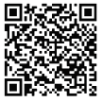
Connect with Marine Corps Housing
https://www.mcrdpi.marines.mil/Resources/For-Depot-Personnel/Housing/
N/A
N/A
N/A
N/A
For information on Marine Corps Housing policies, visit: https://bit.ly/3n2zyGe
October 2021
23

